Slide 1
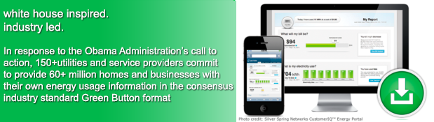
The Green Button Initiative
www.greenbuttondata.org
John Teeter, Computer Scientist, NIST, john.teeter@nist.gov
Presidential Innovation Fellow Alumni

Slide 2
Green Button Technology
-- Consistency
– Interoperability
- Scaling to Market

Slide 3
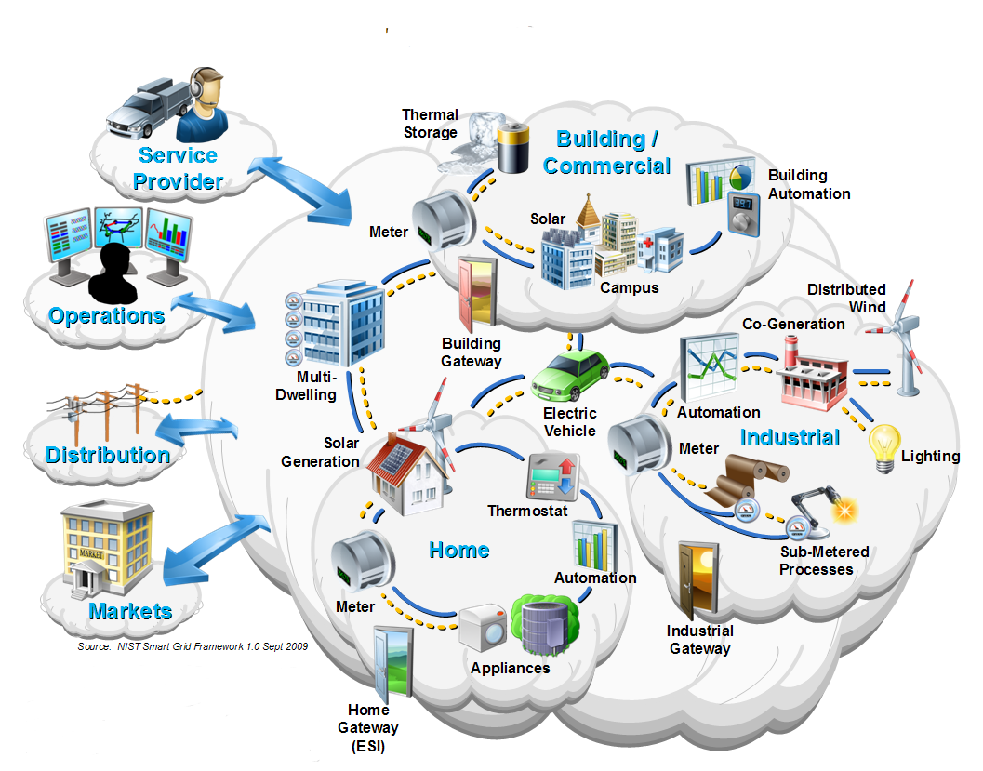

Smart Grid Consumer Domain

Slide 4
Green Button Privacy and Security
Data Security.
Standard Certificate Based HTTPS and SFTP
Uses IETF OAuth2 authorization
Requires 128 bit (Third Party) and 256 bit (Data Custodian) Transport Layer Security
Aligned with NIST best practices
Personal Identifiable Information (PII)
Certified Green Button Metered Data contains no PII
All Location information must be exchanged separately from Metered Data
Account and Portfolio information must be exchanged separately from Metered Data
DOE is leading a Voluntary Code of Conduct Stakeholder Process

Slide 5
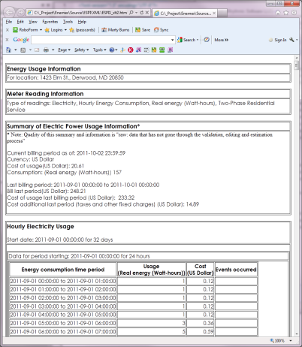
Both Utility and Facility Data
Measurements of power, energy, gas, water, …
Quality: Raw, validated, estimated, …
Source: Meter near real-time, utility back end, third party
Economics: Consumers need to know the cost of their consumed power (but we did not construct a pricing model)
Identification: by customer, device, location
Interval data
Summary Information
Power Quality Metrics
Utility
Data
Facility
Data

Slide 6
Green Button Connect My Data

Slide 7


Green Button Data Exchange
Data Custodian
Third Party
Third Party Registration
Web Service Provider
Web Service Consumer
Automated Transfer
Web Portal
One-time Authorization
Web Portal
Retail Customer
User (agent)

Slide 8
NAESB ESPI REQ.21 aka Green Button

Slide 9
Composition and Atom Feed
Syntactic Model
Atom Feed View
Information Model
Profile View
AtomFeed
LocalTime Parameters
0..1
entrys
Entry:UsagePoint
links
UsagePoint
1
ServiceCategory
Entry:MeterReading
0..*
MeterReading
0..*
IntervalBlock
Entry:ReadingType
0..*
Entry:IntervalBlock
0..*
ElectricPower Usage Summary
1
IntervalReading
ReadingType
Entry:ElectricPowerUsageSummary
0..*
0..*
ElectricPower Quality Summary
ReadingQuality
Entry:ElectricPowerUsageSummary
Note: This information is multidimensional. Many different reading types, summaries, and readings possible. i.e. not “flat”
LocalTime Parameters

Slide 10
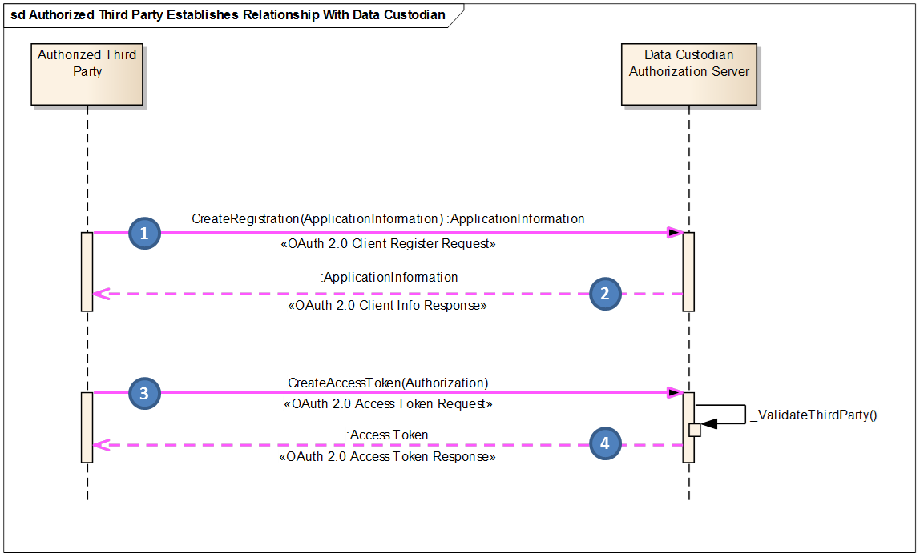
Green Button Connect My Data Registration

Slide 11
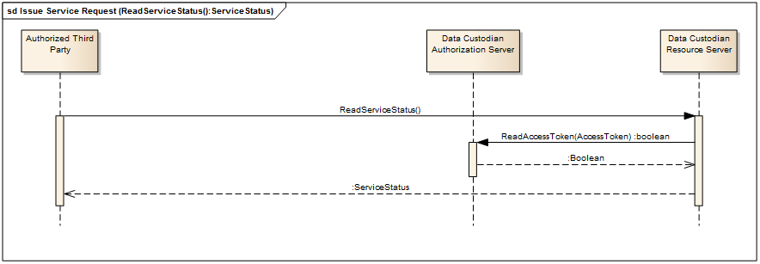
Green Button Connect My Data Status and Notification

Slide 12
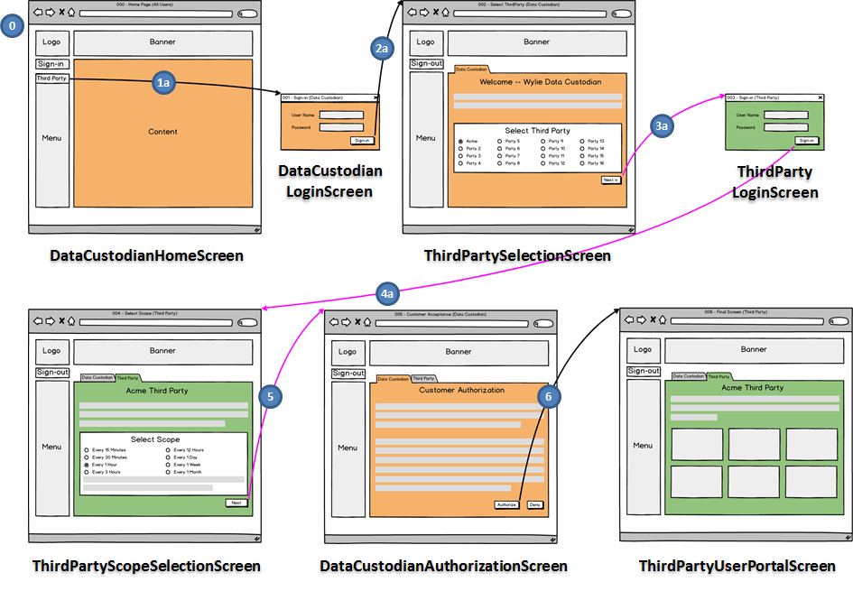
Green Button Connect My Data User Experience Guidelines

Slide 13
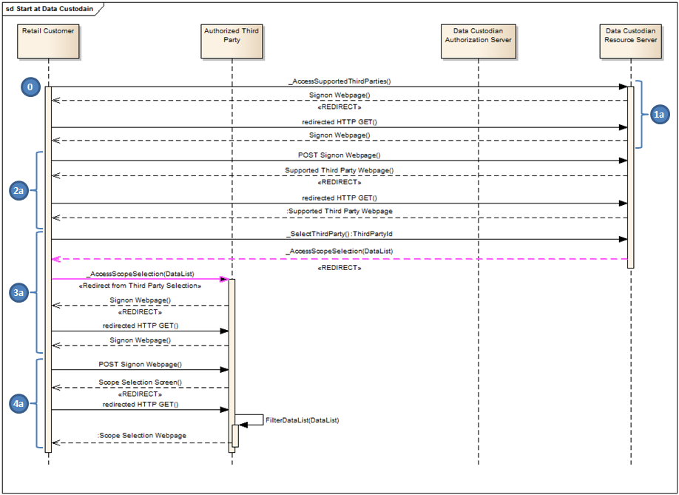
Green Button Connect My Data RetailCustomer Authorization

Slide 14
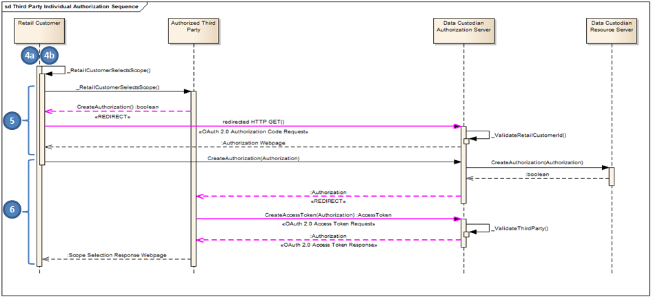
Green Button Connect My Data RetailCustomer Authorization

Slide 15
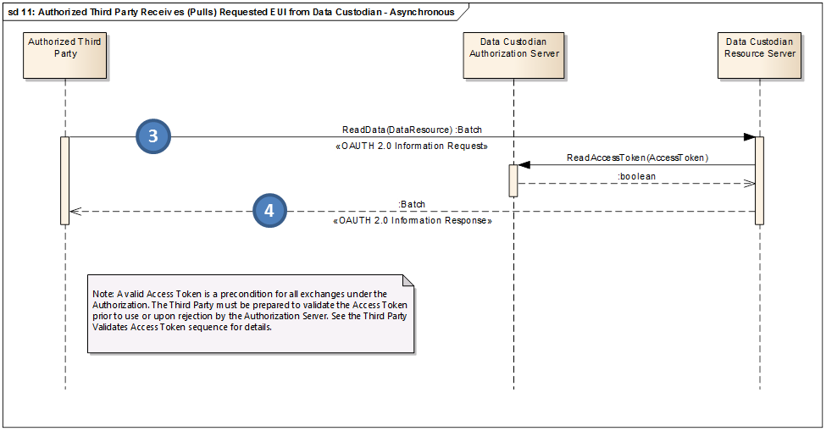
Green Button Connect My Data Data Flows

Slide 16
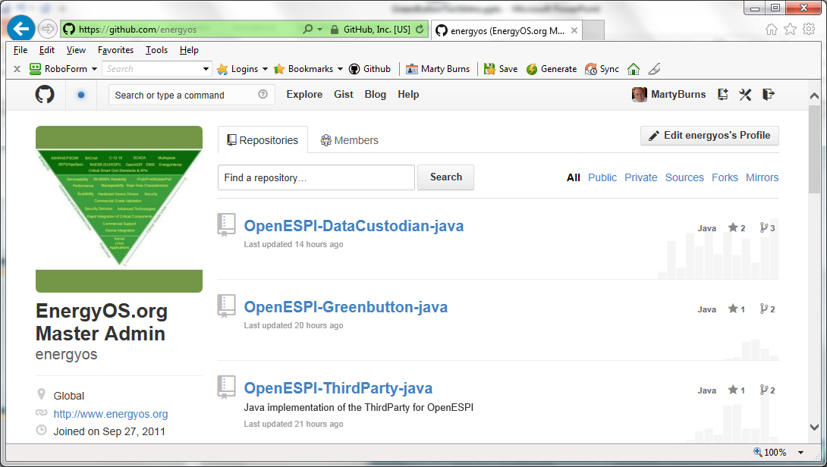
Open Source Green Button https://github.com/energyos

Slide 17
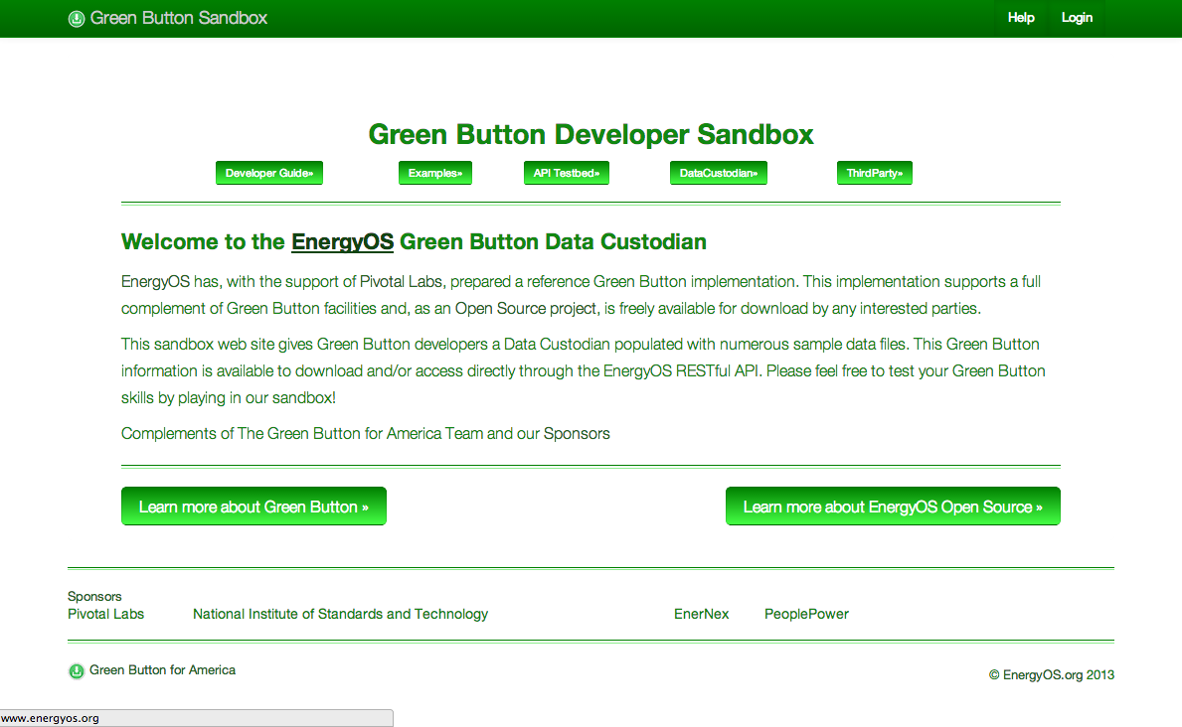
Green Button Connect My Data Sandbox http://services.greenbuttondata.org/

Slide 18
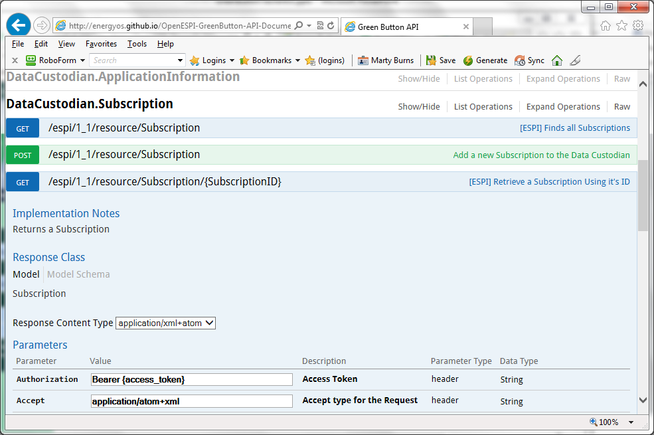
Green Button CMD Live API

Slide 19
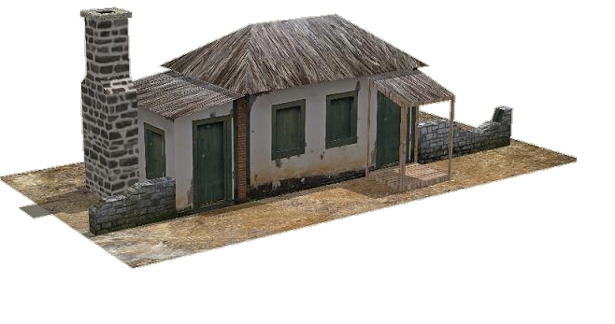
Simple Agency Energy Manager
Rural Co-op
Agency Energy Repository
Agency Registration
Web Service
Web Client
Automated Transfer
Web Portal
One-time Authorization
Web Portal
Utility Meter
Agency Energy Manager
User (agent)

Slide 20
Where is More Technical Information
Base Standard
http://www.naesb.org/ESPI_Standards.asp
Developer Info
Content, Generation, and Samples (DMD)
https://collaborate.nist.gov/twiki-sggrid/bin/view/SmartGrid/GreenButtonSDK
Open Source (DMD/CMD)
http://energyos.github.io/OpenESPI-GreenButton-API-Documentation/API/
http://energyos.github.io/OpenESPI-GreenButton-API-Documentation/
https://github.com/energyos/OpenESPI-Common-java
https://github.com/energyos/OpenESPI-DataCustodian-java
https://github.com/energyos/OpenESPI-ThirdParty-java
SandBox (alpha)
https:/services.greenbuttondata.org/DataCustodian
https:/services.greenbuttondata.org/ThirdParty
Testing and Certification
Download My Data Self-test tool
http://www.greenbuttondata.org/greentest.aspx
UCAIug OpenADE Task Force Testing Artifacts
OpenADE Test Plan Files

Slide 21

Information for YOU!
Thank You

